Slide 1

What is Artificial Intelligence? Machine Learning?
Richard S. Stansbury
CS 455/595a: Artificial Intelligence

Slide 2
Outline
Learning Outcomes
What is AI?
What is ML?
Summary
Questions
References

Slide 3
Learning Outcomes
M0-L2: Define artificial intelligence and machine learning based upon interpretations used within the AI community.

Slide 4
What is Artificial Intelligence?

Slide 5
Defining Intelligence
First, what is intelligence?
Merriam-Webster:
(1): the ability to learn or understand or to deal with new or trying situations : reason; also : the skilled use of reason
(2): the ability to apply knowledge to manipulate one's environment or to think abstractly as measured by objective criteria (as tests)

Slide 6
Weak Artificial Intelligence
A system is said to have weak artificial intelligence if it were to act as if it were intelligent
i.e. capable of solving problems that for a human to solve would require intelligence
Examples:
Medical diagnosis
Object recognition
Route navigation
Assembly line task planning
etc.
Much of the AI/ML techniques covered in this class fall under weak AI techniques and research. Deep learning topics covered later in the course show promise to go beyond just weak AI.

Slide 7
Strong Artificial Intelligence
An system would have strong artificial intelligence if it is capable of actually thinking
i.e. not just simulating thinking
Much more challenging
Opens a variety of philosophical questions regarding what would be the criteria for thinking as a human does

Slide 8
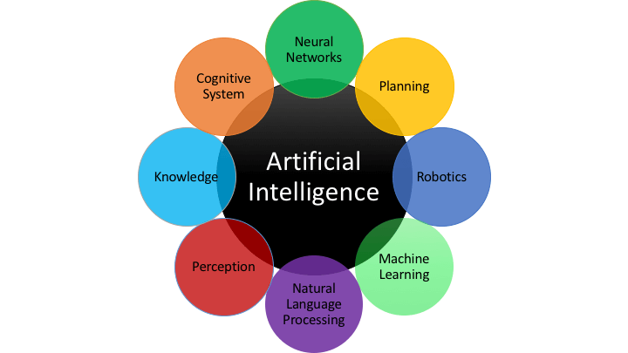
Notes:
Image source: https://www.scoro.com/blog/artificial-intelligence-everything-you-want-to-know/

Slide 9
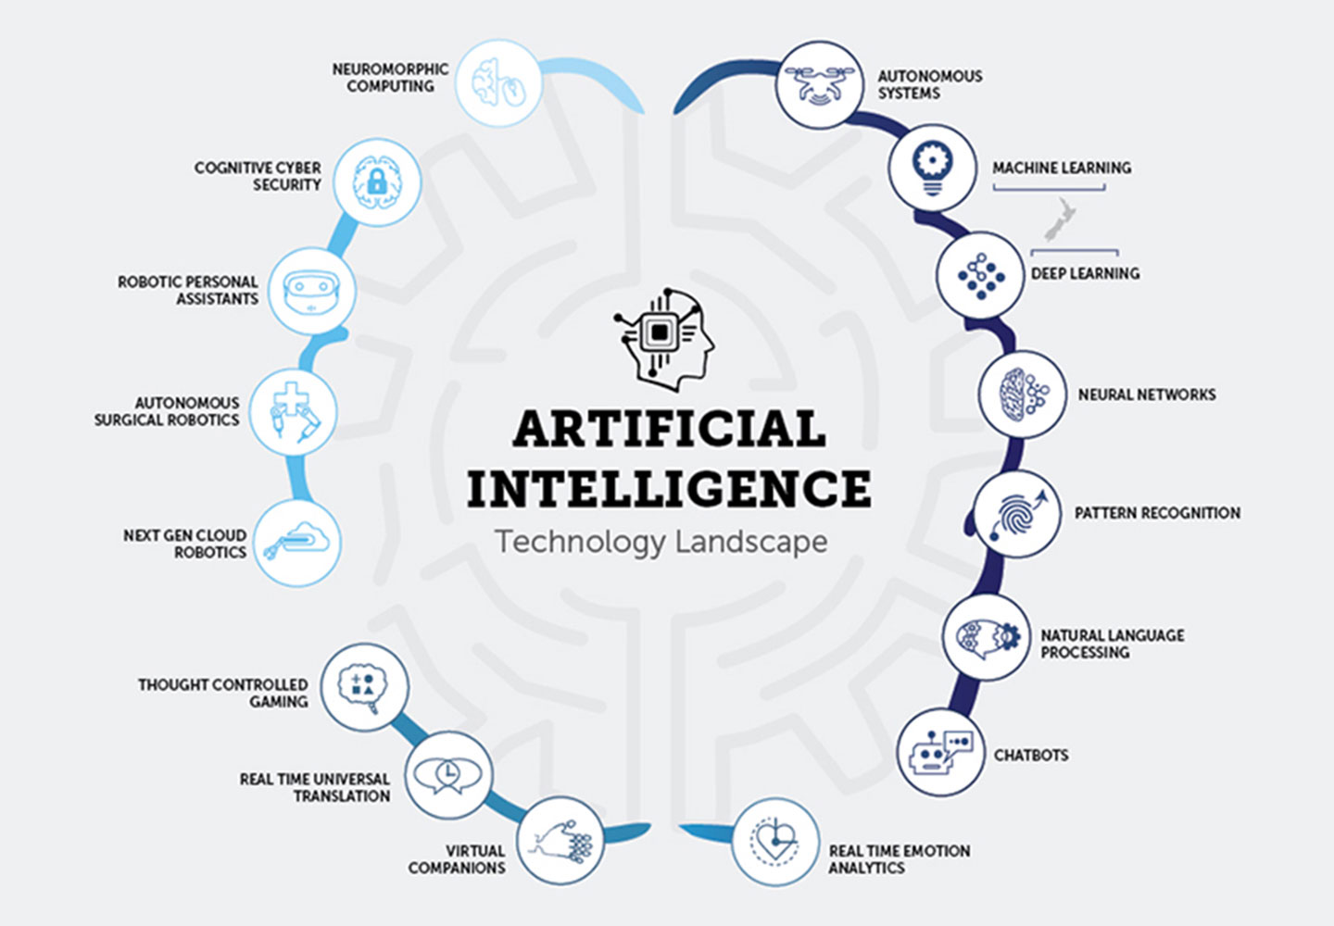
Notes:
https://www.callaghaninnovation.govt.nz/blog/ai-demystified

Slide 10

Agent Paradigm
What is an agent?
An intelligent system may be treated as an “agent” situated within an environment, or simply a situated agent.
It is capable of perceiving its environment through “sensors”
It is capable of acting upon its environment using “actuators”
Paradigm is used for both physical and virtual agents in many AI contexts
But, not all.
Helpful when considering case where the software has some agency within an environment.

Slide 11

Agent Paradigm (2)
Environment
Sensors
Percepts
Actuators
Actions
So, what lies in the middle?

Slide 12
Agent Paradigm (3)
Examples:
Part Inspection Robot
Environment: factory, conveyor belt, parts on conveyor belt
Sensors: camera
Actuators: articulated arm
Medical Diagnosis Program
Environment: medical database, hospital, patients, nurses, etc.
Sensors: Keyboard (input of queries; additional information)
Actuators: Screen (output of diagnosis, queries for more information, treatments, etc.)

Slide 13
Agent Paradigm (4)
Types of Agents:
Simple Reflex Agents:
Respond directly to their precepts
Model-based Reflex Agents
Maintain internal state to reflect aspects of the environment that are not evident in current percept
Goal-based agents
Reasoning directed toward only actions that achieve goals
Utility-based Agents
Reasoning directed toward maximizing overall “happiness” of the system

Slide 14
What is Machine Learning?

Slide 15
Machine Learning
Machine learning can be defined as the ability for a software system to extract and apply knowledge from experience (historic data or past states) to address some tasks/problems and improve its performance (i.e. learn to perform better) over time time
Supervised Learning – learning software is guided through presenting the software with known cases of input and desired output.
Regression – determine continuous result(s) given input (e.g. predicting house prices)
Classification – determines the category of a given input (e.g. classify a radar target by aircraft type)
Unsupervised Learning – learning is performed on data in which the underlying structure is not previously known.
Clustering is an example of unsupervised learning where data is grouped based upon its internal structure/features
Dimension reduction is an unsupervised strategy that can be used to narrow / clean-up data sets for tasks such as visualization or to improve performance of other algorithms.
Reinforcement Learning - learns to respond to its state and stimuli through the reinforcement of which actions provided favorable results vs. which options provided less favorable results.

Slide 16
What is the difference between AI and ML?
Artificial Intelligence is a broader discipline than machine learning.
Includes a variety of topics such as:
Problem solving
Reasoning
Planning
Learning
Collaboration
Machine Learning addresses the learning topics of AI and several off-shoot topics
Image processing
Natural language processing
Autonomy-based on reinforcement learning
Data analysis / statistics

Slide 17
What is the difference between data science and machine learning?
In the news, data science and machine learning are often described interchangeably
Machine learning typically is derived from the computer science and AI communities
Often utilize Python tools and libraries to support software development
Data science is typically associated with the mathematics / statistics communities
Often utilize R tools and its libraries to support data analysis and visualization
Data engineering is described by some as the intersection of data science/machine learning with data management, data warehousing, devops, etc.
In general, these topics have significant overlap, but we will focus upon machine learning, which is more oriented toward the application of learning algorithms to software systems.

Slide 18

Notes:
Image Source: https://scikit-learn.org/stable/tutorial/machine_learning_map/index.html

Slide 19
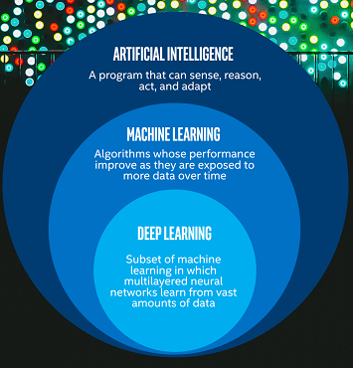
Notes:
Image source: https://scikit-learn.org/stable/tutorial/machine_learning_map/index.html

Slide 20
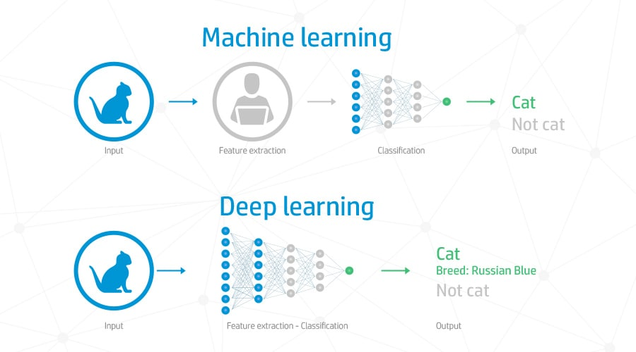
Notes:
Image Source: http://www.compcenter.com/client/index.cfm/2018/7/30/Machine-Learning--Deep-Learning-101

Slide 21
Wrap-up

Slide 22
Summary
In general, we can define AI and ML as follows:
AI is the concept of developing software that is capable of performing tasks that would typically require some form of intelligence.
Machine learning is a sub-domain of AI focused on enabling learning within the system through supervised and unsupervised means.
Community consensus on definitions still evolving
Broad domains
AI/ML include numerous sub-domains, which can be divided further.
Advances such as deep learning show potential for moving AI from weak toward strong.

Slide 23
Questions
Notes:
Image Source: https://svgsilh.com/image/1751308.html

Slide 24
References
Callaghan Innovation. “AI Demystified.” Online at: https://www.callaghaninnovation.govt.nz/blog/ai-demystified, last accessed 01/03/2019.
Intel AI Academy, “Infographic: Get Started with AI Development Today,” Online at: https://software.intel.com/en-us/articles/infographic-get-started-with-ai-development-today, last accessed 01/03/2019.
Liise Ruuse, “Artificial Intelligence: Everything You Want to Know,” Scoro, Online at: https://www.scoro.com/blog/artificial-intelligence-everything-you-want-to-know/, last accessed 01/03/2019.
SKLearn.org, “Choosing the Right Estimator”, Online at: https://scikit-learn.org/stable/tutorial/machine_learning_map/index.html, last accessed 01/03/2019.
The Computing Center, “Machine Learning & Deep Learning 101” Online at: http://www.compcenter.com/client/index.cfm/2018/7/30/Machine-Learning--Deep-Learning-101, last accessed 01/03/2019.

